Slide 1

Constructing a Case for Equity Theory
Notes:
[TEACHING NOTE: THIS INTRODUCTION SLIDE IS SPECIFIC TO THE ACTIVITY DEBRIEFING. DO NOT USE IT WHEN YOU ADMINISTER THE CONSTRUCTION CREW SURVEY (i.e., DO NOT REVEAL THAT THE ACTIVITY RELATES TO EQUITY THEORY. USE THIS INTRODUCTORY SLIDE FOR YOUR EXTENDED DISCUSSION OF EQUITY THEORY OR SIMPLY INCORPORATE THE SLIDES THAT FOLLOW INTO YOUR MOTIVATION PRESENTATION. THE DISCOURSE BELOW CAN BE USED TO INTRODUCE EQUITY THEORY. ANOTHER EFFECTIVE WAY TO INTRODUCE EQUITY THEORY IS TO FIND ALLY BANK’S “WOULD YOU LIKE A PONY?” COMMERCIAL ONLINE AND PLAY IT FOR THE CLASS. THIS VERY SHORT VIDEO PROVIDES AN EXCELLENT ILLUSTRATION OF EQUITY THEORY FROM A CHILD’S POINT OF VIEW. ASKING STUDENTS TO EXPLAIN WHAT OCCURRED HELPS THEM RECOGNIZE THAT WE HAVE AN INNATE SENSE OF EQUITY/FAIRNESS.]
Let’s imagine that you took an exam during our last class meeting. Today, I return the graded exams to you. What will you do when you get yours and why will you do that? In other words, how will you review the exam to determine whether the grading is accurate/fair and how will the information you gather influence your motivation to prepare for the next exam? [TEACHING NOTE: THIS SETUP CAN BE AN EFFECTIVE ILLUSTRATION TO INTRODUCE BOTH EQUITY THEORY AND EXPECTANCY THEORY.]
What is the first thing you do when you get an exam (or project) back? Answer: You look at the score? Then you probably scan through parts of the exam to understand how points were allocated and where you lost points. Is that enough information to establish that your score is accurate/fair? Answer: Probably not completely. What else will you do to make that determination? Answer: Ask someone else that you know in the class how they did. Why is checking with someone else important? Answers: Because I do not know if my score is fair/I have been treated consistently with everyone else without a comparison; I need to “see” what happened to others in the same context. Point out that this “comparison other” is called a referent and that the referent should be someone with a similar experience to ours (i.e., it would not make sense to ask a student from a completely different course how they did not their exam).

Slide 2
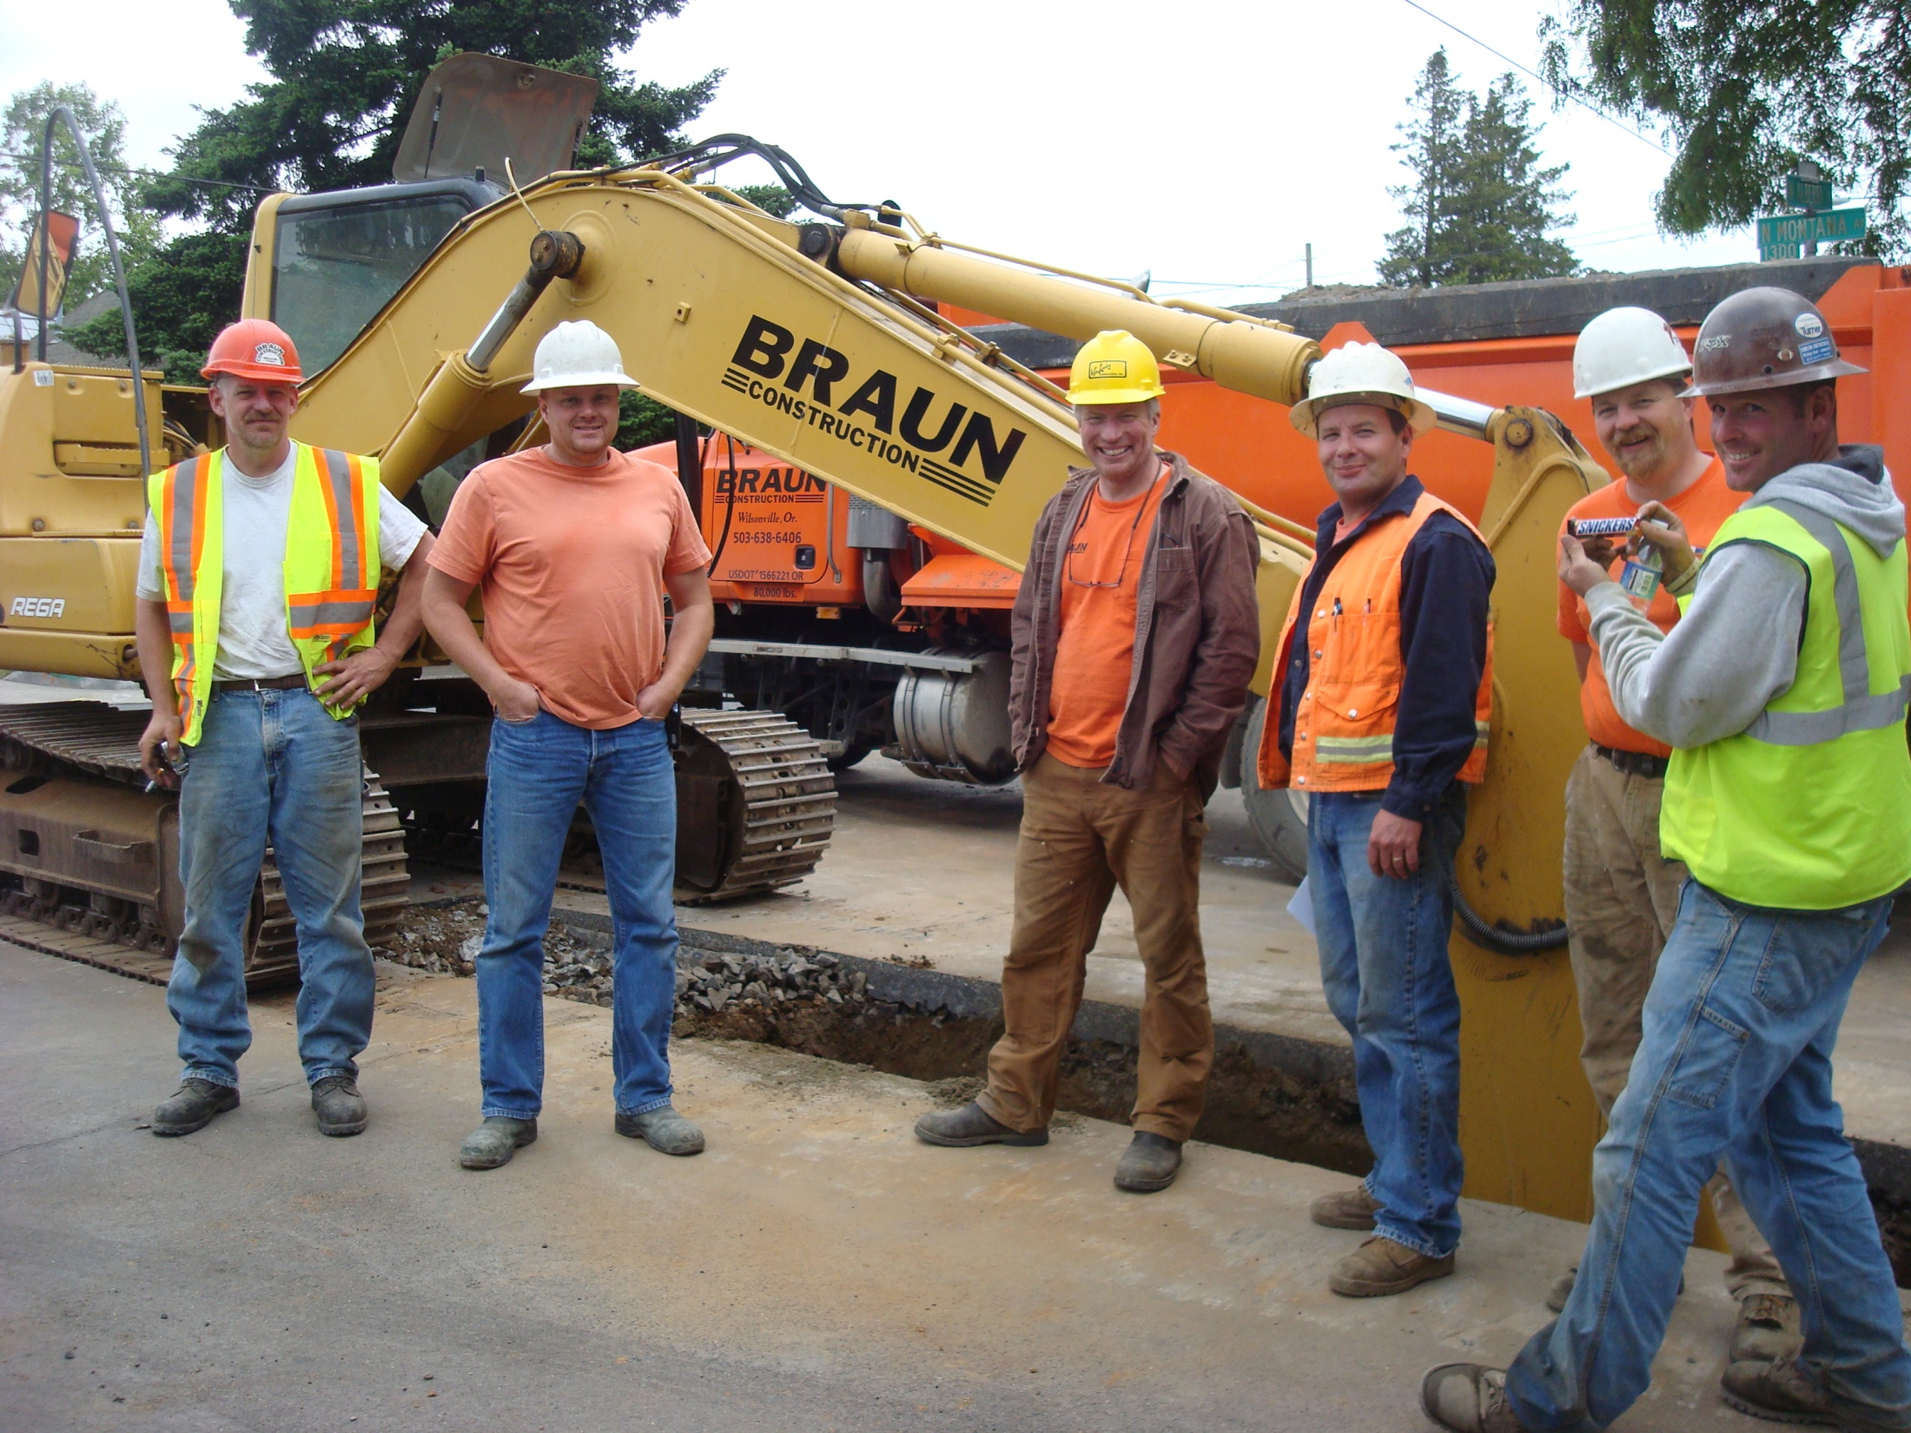
Notes:
[TEACHING NOTE: USE THIS SLIDE BY ITSELF AS THE VISUAL FOR ADMINISTERING THE CONSTRUCTION CREW SALARY SURVEY ONE SESSION PRIOR TO YOUR FIRST MOTIVATION SESSION. THEN ALSO DISPLAY IT AS PART OF THIS PRESENTATION TO REMIND STUDENTS ABOUT THE ACTIVITY.]
Do you remember our construction crew activity? You were provided a description of six members of a construction crew and asked to generate a reasonable hourly salary for each. Then you were told that the union representing construction workers suggested a uniform hourly rate of $29.50. You were asked whether that proposal was reasonable. You were also asked to provide an explanation for your response.

Slide 3
Pay Them Equally (Same Amount / Hour)?
Laborers’ International Union of North America, which represents these employees, recently recommended that everyone on the crew receive the same hourly rate of $29.50. Do believe this is reasonable?
 | Responses
No | xx
Yes | x*
* “Yes” respondents did not make individual pay allocations equally.
There may have been some misinterpretation of the “equal pay” question.
Notes:
[TEACHING NOTE: TABULATE THE RESPONSES FROM YOUR CLASS SURVEY AND RECORD THEM HERE. FOR ANY STUDENT THAT RESPONDS “YES” TO THE EQUAL PAY QUESTION, CHECK WHETHER THEIR INDIVIDUAL WORKER PAY ALLOCATIONS IN THE FIRST PART MATCH THAT SENTIMENT (i.e., THE INDIVIDUAL ALLOCATIONS SHOULD ALL BE THE SAME) AND NOTE HOW MANY WERE (IN)CONSISTENT IN THEIR RESPONSES TO THE FIRST AND SECOND PARTS. REVIEW THE EXPLANATIONS FOR ALL RESPONDENTS. BE PREPARED TO EXPLAIN AS YOU REPORT THE RESULTS WHY “YES” RESPONDENTS ANSWERED AS THEY DID. FROM THE AUTHOR’S EXPERIENCE, MOST STUDENTS RESPONDING YES TO THE EQUAL PAY IDEA THINK THAT THE $29.50/HOUR FIGURE IS THE MINIMUM ANY WORKER SHOULD RECEIVE, BUT NOT THAT THEY SHOULD ALL RECEIVE THE SAME AMOUNT.]
The primary focus of our construction crew activity was a single question about whether six workers should all be paid the same. XX of you participated and the response was compelling. Most of you indicated the workers should not receive the same pay. Further, of the XX that responded “yes,” XX pay allocations were consistent with the thinking. Your responses for the activity were consistent with those given every other semester.

Slide 4
Equal Pay Objections
Education/Knowledge Differences
Experience/Training Differences
Skill (Specialization) Differences
Certifications
Tenure (Length of Time with Company)
Nature of Job (Qualifications, Difficulty, Responsibilities)
Market Demands (for Certain Skills)
Destroys Motivation (Equal Pay Is a Disincentive to Work Hard)
Notes:
[TEACHING NOTE: DEVELOP A LIST OF REASONS THAT STUDENTS DO NOT THINK EQUAL PAY IS REASONABLE. YOUR LIST WILL BE SIMILAR TO THE ONE PRESENTED HERE. ADJUST RESPONSES AS NECESSARY.]
I asked you to explain your answer to the equal pay question. These are reasons you indicated that workers should not receive the same amount of pay. In short, you indicated that pay should be based on merit, what the worker brings to the organization. Think about it. That is the same reason so many students do not like group projects – everybody in the group gets the same grade, but members do not always contribute equally. I will return to our activity in a moment.

Slide 5
Equity Theory Proposition
Manager allocates rewards
Individual makes equity comparisons
Job satisfaction and performance are affected
Notes:
[TEACHING NOTE: I USUALLY CONDUCT A PARTIAL DEBRIEFING OF THE CONSTRUCTION CREW EXERCISE (i.e., THE PREVIOUS SLIDES) BEFORE I INTRODUCE PROCESS THEORIES OF MOTIVATION. THEN I INTRODUCE BASIC ELEMENTS OF EQUITY AND INCORPORATE SUPPORTING COMMENTS FROM THE ACTIVITY.]
Before we examine the components of Equity Theory, let’s consider why equity evaluations are necessary. When we participate with others in organizations, we do so to gain certain outcomes. In school, you are mostly interested in grades. At work, we want pay and benefits, but we might also care about work assignments, recognition, and promotion. Most of these outcomes are determined by a third party, that is, a boss. When the boss/manager makes decisions about how these outcomes are allocated, [CLICK] we make equity comparisons (e.g., like asking another student what grade they received on an exam) and [CLICK] these evaluations determine how we feel about the organization and influence subsequent motivation.

Slide 6
Equity Theory Questions
What did I do?
What did I get for doing it?
What did others do / get?
Notes:
How do we make equity comparisons. [CLICK] When individuals evaluate the outcomes they receive from others, they begin by assessing what they did to gain the outcome. [CLICK] Next, they evaluate what they got for doing it. [CLICK] That brings us to the third element that is the essence of equity comparisons. Not only do we examine our contributions and outcomes, but we evaluate what others in similar circumstances did and got for doing it. These social comparisons give context to our outcomes. [TEACHING NOTE: IF THE ALLY BANK COMMERCIAL WAS USED, YOU CAN MENTION THAT THE DARK-HEADED GIRL’S REACTION WAS INITIALLY POSITIVE BUT BECAME NEGATIVE AFTER A COMPARISON OF THE OUTCOME SHE RECEIVED AND THE BLOND GIRL’S OUTCOME.]

Slide 7



Equity Theory Perceptions
Note
O / I = 7 / 5 _{Me} : O / I = 14 / 10 _{You}
is also balanced
Equity
O / I = 7 / 5 _{Me}
O / I = 7 / 5 _{You}
Positive Inequity
(Guilt)
O / I = 9 / 5 _{Me}
O / I = 7 / 5 _{You}
Negative Inequity
(Anger)
O / I = 7 / 5 _{Me}
O / I = 7 / 3 _{You}
O / I = Ratio of Outcomes to Inputs
Notes:
That is the essence of Equity Theory, which states that when outcome-input ratios are balanced situations are viewed as fair, and employees are motivated to keep doing what they do. Bear in mind that our outcomes do not need to be identical. It is okay for me to make twice as much as you if I contribute twice as much. When the ratio is out of balance, motivations change. [CLICK] We can experience positive inequity, where the ratio is out of balance and in our favor. That leads to some level of guilt. Adams says workers will either be motivated to ramp up the quality of their work or simply justify reasons why the imbalance exists (e.g., my college degree was acquired from a better university than yours). Over time, they get used to the difference and it does not affect motivation.
[CLICK] It is the third condition that is most crucial. Sometimes we might experience negative inequity. Things are out of balance and not in our favor. This result leads to anger. Adams says workers become highly motivated to fix the situation. Notice that I depicted the imbalance differently here (e.g., the outcomes are the same, but the inputs are different). The truth is any imbalance can result in feelings of positive or negative inequity. If I make more money than you for the same level of input or have the same level of outcome for less input, I have positive inequity. If I have the same level of outcome and you contribute fewer inputs or we contribute the same inputs, but I have lesser outcomes, I will experience negative inequity.
What are some of the ways that individuals respond to negative equity (i.e., how do we attempt to fix this condition)?
Ask for a raise (i.e., increase my outcomes)
Slack off – not work as hard (i.e., decrease my inputs) [TEACHING NOTE: IT IS IMPORTANT TO EXPRESS HERE THAT INDIVIDUALS NEVER RESPOND TO NEGATIVE INEQUITY BY INCREASING THEIR INPUTS – THAT MAKES THE DISPARITY EVEN WORSE.]
Quit (i.e., find a different organization that treats individuals fairly)
Change comparisons (i.e., find a new referent – women are most likely to do that – and adjust the evaluation)
Shift tasks to the other individual (i.e., decrease our inputs while increasing theirs)
[TEACHING NOTE: AT THIS POINT IT MAY HELP TO REINTRODUCE THE CONSTRUCTION CREW ACTIVITY. REMIND STUDENTS THAT MOST DID NOT THINK EQUAL PAY (i.e., SAME OUTCOMES) WAS REASONABLE. THE EXPLANATION FOR REJECTING EQUAL PAY WAS THAT THESE WORKERS CONTRIBUTED DIFFERENT LEVELS OF INPUT BASED ON DIFFERENT FACTORS.]

Slide 8
Organizational Justice Streams
Distributive Justice (i.e., did I get what I deserved?)
Procedural Justice (i.e., were the rules followed, was all relevant evidence heard/considered, was I able to contribute information for consideration?)
Interactional Justice (i.e., was I treated with dignity and respect, was the decision properly explained?)
Notes:
[TEACHING NOTE: IF TIME PERMITS, MENTION THAT EQUITY THEORY CODIFIED THE NOTION OF FAIRNESS WHEN EVALUATING OUTCOMES. THAT GAVE RISE TO THINKING ABOUT DISTRIBUTIVE JUSTICE AND, SUBSEQUENTLY, TO TWO OTHER STREAMS OF JUSTICE.]
Equity Theory incorporates an evaluation of fairness, or justice, into evaluations of outcomes that are determined by someone else. When we speak of justice, we mean behavior (decisions) that are impartial, fair, and equitable with respect to the individuals involved. There are three basic streams (or ideas) that have emerged. These are:
Distributive Justice – addresses the allocation of an outcome and is grounded in equity theory; rewards should be proportional to one’s inputs and not influenced by some category to which an individual belongs; example of distributive injustice: higher grades are given to female than male students (note: the workplace equivalent would be women earning less than males for comparable work)
Procedural Justice – addresses the rules or procedures used by decision makers in the allocation of outcomes; are rules clearly stated and applied consistently; are all relevant factors considered and do the individuals affected have an opportunity to provide information (i.e., voice); example of procedural injustice: an instructor uses criteria to evaluate a project that was not made known ahead of time (i.e., not in the project description or on a grading rubric provided in advance). A workplace equivalent might be nepotism or the boss’ favorites receiving raises/bonuses/promotions while qualified others do not.
Interactional Justice – addresses the quality of the treatment received from decision makers; example of interactional injustice: when a student inquires why they received a mediocre grade for a project, the instructor responds, “Because you are stupid for not following directions and I think you are lazy.” A workplace equivalent might be the use of sexist language when explaining outcomes.

